Slide 1
Machine Programming I: Basics
History of Intel processors and architectures
Assembly Basics: Registers, operands, move
Arithmetic & logical operations

Slide 2
Intel x86 Processors
Dominate laptop/desktop/server market
Evolutionary design
Backwards compatible up until 8086, introduced in 1978
Added more features as time goes on
Complex instruction set computer (CISC)
Many different instructions with many different formats
But, only small subset encountered with Linux programs
Hard to match performance of Reduced Instruction Set Computers (RISC)
But, Intel has done just that!
In terms of speed. Less so for low power.

Slide 3
Intel x86 Evolution: Milestones
Name Date Transistors MHz
8086 1978 29K 5-10
First 16-bit Intel processor. Basis for IBM PC & DOS
1MB address space
386 1985 275K 16-33
First 32 bit Intel processor , referred to as IA32
Added “flat addressing”, capable of running Unix
Pentium 4E 2004 125M 2800-3800
First 64-bit Intel x86 processor, referred to as x86-64
Core 2 2006 291M 1060-3500
First multi-core Intel processor
Core i7 2008 731M 1700-3900
Four cores

Slide 4
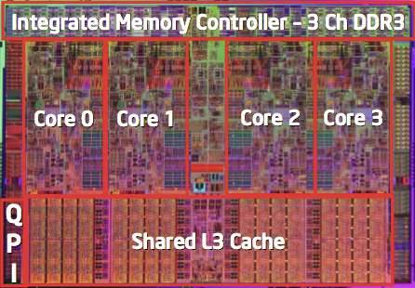
Intel x86 Processors, cont.
Machine Evolution
386 1985 0.3M
Pentium 1993 3.1M
Pentium/MMX 1997 4.5M
PentiumPro 1995 6.5M
Pentium III 1999 8.2M
Pentium 4 2001 42M
Core 2 Duo 2006 291M
Core i7 2008 731M
Added Features
Instructions to support multimedia operations
Instructions to enable more efficient conditional operations
Transition from 32 bits to 64 bits
More cores

Slide 5
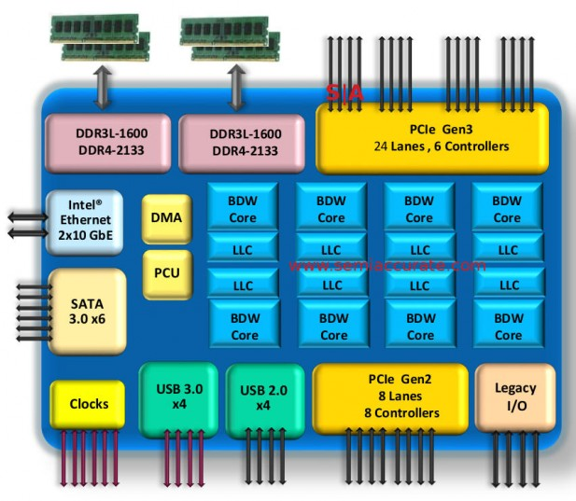
2015 State of the Art
Core i7 Broadwell 2015
Desktop Model
4 cores
Integrated graphics
3.3-3.8 GHz
65W
Server Model
8 cores
Integrated I/O
2-2.6 GHz
45W

Slide 6
x86 Clones: Advanced Micro Devices (AMD)
Historically
AMD has followed just behind Intel
A little bit slower, a lot cheaper
Then
Recruited top circuit designers from Digital Equipment Corp. and other downward trending companies
Built Opteron: tough competitor to Pentium 4
Developed x86-64, their own extension to 64 bits
Recent Years
Intel got its act together
Leads the world in semiconductor technology
AMD has fallen behind
Relies on external semiconductor manufacturer

Slide 7
Intel’s 64-Bit History
2001: Intel Attempts Radical Shift from IA32 to IA64
Totally different architecture (Itanium)
Executes IA32 code only as legacy
Performance disappointing
2003: AMD Steps in with Evolutionary Solution
x86-64 (now called “AMD64”)
Intel Felt Obligated to Focus on IA64
Hard to admit mistake or that AMD is better
2004: Intel Announces EM64T extension to IA32
Extended Memory 64-bit Technology
Almost identical to x86-64!
All but low-end x86 processors support x86-64
But, lots of code still runs in 32-bit mode

Slide 8
Definitions
Architecture: (also ISA: instruction set architecture) The parts of a processor design that one needs to understand or write assembly/machine code.
Examples: instruction set specification, registers.
Microarchitecture: Implementation of the architecture.
Examples: cache sizes and core frequency.
Code Forms:
Machine Code: The byte-level programs that a processor executes
Assembly Code: A text representation of machine code
Example ISAs:
Intel: x86, IA32, Itanium, x86-64
ARM: Used in almost all mobile phones

Slide 9
Assembly/Machine Code View
CPU
Memory
Registers
Addresses
Data
Code
Data
Stack
PC
Condition
Codes
Instructions
Programmer-Visible State
PC: Program counter
Address of next instruction
Called “RIP” (x86-64)
Register file
Heavily used program data
Condition codes
Store status information about most recent arithmetic or logical operation
Used for conditional branching
Memory
Byte addressable array
Code and user data
Stack to support procedures

Slide 10
Assembly Characteristics: Data Types
“Integer” data of 1, 2, 4, or 8 bytes
Data values
Addresses (untyped pointers)
Floating point data of 4, 8, or 10 bytes
Code: Byte sequences encoding series of instructions
No aggregate types such as arrays or structures
Just contiguously allocated bytes in memory

Slide 11
Data Formats
Word – refers to a 16-bit data type
32-bit: double word
64-bit: quad word
In x86-64
code Suffix size (byte)
char byte b 1
short word w 2
int double l 4
long quad q 8
char * quad q 8
float single prec. s 4
double double prec. l 8

Slide 12
x86-64 Integer Registers
%rax
%r8
%eax
%r8d
%rbx
%r9
%ebx
%r9d
%rcx
%r10
%ecx
%r10d
%rdx
%r11
%edx
%r11d
%rsi
%r12
%esi
%r12d
%rdi
%r13
%edi
%r13d
%rsp
%r14
%esp
%r14d
%rbp
%r15
%ebp
%r15d
Can reference low-order 4 bytes (also low-order 1 & 2 bytes)

Slide 13
Some History: IA32 Registers
Origin
(mostly obsolete)
%eax
%ax
%ah
%al
accumulate
%ecx
%cx
%ch
%cl
counter
%edx
%dx
%dh
%dl
data
general purpose
%ebx
%bx
%bh
%bl
base
%esi
source
index
%si
%edi
destination
index
%di
%esp
stack
pointer
%sp
%ebp
base
pointer
%bp
16-bit virtual registers
(backwards compatibility)

Slide 14
Moving Data
%rax
%rcx
Moving Data
movq Source, Dest:
Operand Types
Immediate: Constant integer data
Example: $0x400, $-533
Like C constant, but prefixed with ‘$’
Encoded with 1, 2, or 4 bytes
Register: One of 16 integer registers
Example: %rax, %r13
But %rsp reserved for special use
Others have special uses for particular instructions
Memory: 8 consecutive bytes of memory at address given by register
Simplest example: (%rax)
Various other “address modes”
%rdx
%rbx
%rsi
%rdi
%rsp
%rbp
%rN

Slide 15
movq Operand Combinations
Source
Dest
Src,Dest
C Analog
Reg
movq $0x4,%rax
temp = 0x4;
Imm
Mem
movq $-147,(%rax)
*p = -147;
Reg
movq %rax,%rdx
temp2 = temp1;
movq
Reg
Mem
movq %rax,(%rdx)
*p = temp;
Mem
Reg
movq (%rax),%rdx
temp = *p;
Cannot do memory-memory transfer with a single instruction

Slide 16
Simple Memory Addressing Modes
Normal (R) Mem[Reg[R]]
Register R specifies memory address
Aha! Pointer dereferencing in C movq (%rcx),%rax
Displacement D(R) Mem[Reg[R]+D]
Register R specifies start of memory region
Constant displacement D specifies offset movq 8(%rbp),%rdx

Slide 17
Example of Simple Addressing Modes
void swap
(long *xp, long *yp)
{
long t0 = *xp;
long t1 = *yp;
*xp = t1;
*yp = t0;
}
swap:
movq (%rdi), %rax
movq (%rsi), %rdx
movq %rdx, (%rdi)
movq %rax, (%rsi)
ret

Slide 18
Understanding Swap()
Memory
void swap
(long *xp, long *yp)
{
long t0 = *xp;
long t1 = *yp;
*xp = t1;
*yp = t0;
}
Registers
%rdi
%rsi
%rax
%rdx
Register Value
%rdi xp
%rsi yp
%rax t0
%rdx t1
swap:
movq (%rdi), %rax # t0 = *xp
movq (%rsi), %rdx # t1 = *yp
movq %rdx, (%rdi) # *xp = t1
movq %rax, (%rsi) # *yp = t0
ret

Slide 19
Understanding Swap()
Memory
Registers
Address
123
0x120
%rdi
0x120
0x118
%rsi
0x100
0x110
%rax
0x108
%rdx
456
0x100
swap:
movq (%rdi), %rax # t0 = *xp
movq (%rsi), %rdx # t1 = *yp
movq %rdx, (%rdi) # *xp = t1
movq %rax, (%rsi) # *yp = t0
ret

Slide 20
Understanding Swap()
Memory
Registers
Address
123
0x120
%rdi
0x120
0x118
%rsi
0x100
0x110
%rax
123
0x108
%rdx
456
0x100
swap:
movq (%rdi), %rax # t0 = *xp
movq (%rsi), %rdx # t1 = *yp
movq %rdx, (%rdi) # *xp = t1
movq %rax, (%rsi) # *yp = t0
ret

Slide 21
Understanding Swap()
Memory
Registers
Address
123
0x120
%rdi
0x120
0x118
%rsi
0x100
0x110
%rax
123
0x108
%rdx
456
456
0x100
swap:
movq (%rdi), %rax # t0 = *xp
movq (%rsi), %rdx # t1 = *yp
movq %rdx, (%rdi) # *xp = t1
movq %rax, (%rsi) # *yp = t0
ret

Slide 22
Understanding Swap()
Memory
Registers
Address
456
0x120
%rdi
0x120
0x118
%rsi
0x100
0x110
%rax
123
0x108
%rdx
456
456
0x100
swap:
movq (%rdi), %rax # t0 = *xp
movq (%rsi), %rdx # t1 = *yp
movq %rdx, (%rdi) # *xp = t1
movq %rax, (%rsi) # *yp = t0
ret

Slide 23
Understanding Swap()
Memory
Registers
Address
456
0x120
%rdi
0x120
0x118
%rsi
0x100
0x110
%rax
123
0x108
%rdx
456
123
0x100
swap:
movq (%rdi), %rax # t0 = *xp
movq (%rsi), %rdx # t1 = *yp
movq %rdx, (%rdi) # *xp = t1
movq %rax, (%rsi) # *yp = t0
ret

Slide 24
Simple Memory Addressing Modes
Normal (R) Mem[Reg[R]]
Register R specifies memory address
Aha! Pointer dereferencing in C movq (%rcx),%rax
Displacement D(R) Mem[Reg[R]+D]
Register R specifies start of memory region
Constant displacement D specifies offset movq 8(%rbp),%rdx

Slide 25
Complete Memory Addressing Modes
Most General Form
D(Rb,Ri,S) Mem[Reg[Rb]+S*Reg[Ri]+ D]
D: Constant “displacement” 1, 2, or 4 bytes
Rb: Base register: Any of 16 integer registers
Ri: Index register: Any, except for %rsp
S: Scale: 1, 2, 4, or 8 (why these numbers?)
Special Cases
(Rb,Ri) Mem[Reg[Rb]+Reg[Ri]]
D(Rb,Ri) Mem[Reg[Rb]+Reg[Ri]+D]
(Rb,Ri,S) Mem[Reg[Rb]+S*Reg[Ri]]

Slide 26
Address Computation Examples
Carnegie Mellon
%rdx | 0xf000
%rcx | 0x0100
Expression | Address Computation | Address
0x8(%rdx)
(%rdx,%rcx)
(%rdx,%rcx,4)
0x80(,%rdx,2)
Expression | Address Computation | Address
0x8(%rdx) | 0xf000 + 0x8 | 0xf008
(%rdx,%rcx) | 0xf000 + 0x100 | 0xf100
(%rdx,%rcx,4) | 0xf000 + 4*0x100 | 0xf400
0x80(,%rdx,2) | 2*0xf000 + 0x80 | 0x1e080
Notes:
0xf000 + 0x8 = 0xf008
0xf000 + 0x0100 = 0xf100
0xf000 + 4*0x0100 = 0xf400
2*0xf000 + 0x80 = 0x1d080

